Slide 1
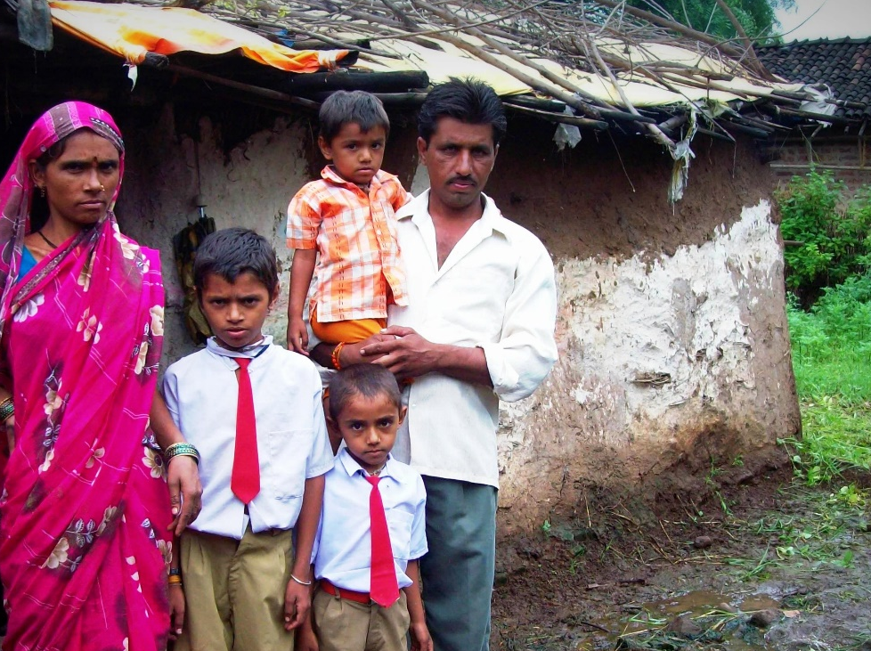

Financial inclusion | वित्तीय समोवेशन: 4 Pillars
Banking
Credit
Insurance
Investment
Small Savings,
PM SB, JJ
Pension
“Social Security”
Notes:
Credit
Loan @affordable rates
Savings
Banking
Small Savings
Investment
Long term Lifecycle needs
PENSION, Higher Education
Insurance
Life and Non-Life (General)

Slide 2
Social security =Protecting worker & his family, against health and work related eventualities.
Health / work related eventualities
Why SS?
Treatment
Compensation
If no SS?
Child labour
Death
Maternity
Sickness
Rehabilitation
Prostitution
Destitution
Human dignity
Crime
Disability
Unemployment

Slide 3
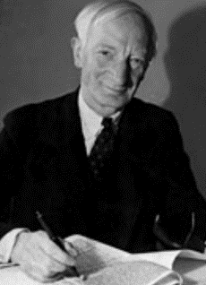
Sir William Beveridge (1879-1963)
SS
Born in Bengal, economist
1942: Report- social insurance
1945: PM Clement Attlee (Labour) replaced PM Winston Churchill (Conservative)
Attlee promised to implement Beveridge report- Social security from cradle to grave; Free medical treatment to all.
Prof.B.P.Adarkar -> 1st Social security scheme in 1944
Sardar Patel nicknamed him “Chhota Beveridge”.
Self study for EPFO exam

Slide 4
DPSP
Constitution
Article 42: just and humane conditions of work and for maternity relief <more under BES17 ”4”>
Article 41: State to provide public assistance to its citizens in case of unemployment, old age, sickness and disablement
1948
Employee State Insurance Corporation Act (ESIC)
51-52
EPFO: Ordinance & Then act. J&K..x
Labour Ministry. 3 party board, 3 scheme
1952 scheme: Nehru first to join. health & accident insurance Features click me
Notes:
1948: Employees' State Insurance Act
ESIC = “Corporation”, not Company.
24th Feb. 1952: Employee state insurance scheme, Nehru 1st to join
‘51: Ordinance
‘52: EPF Act, except J&K.
Under administrative control of Ministry of Labour and Employment
3 party board
3 schemes

Slide 5
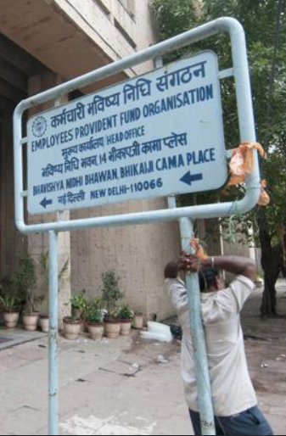
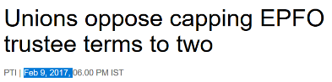
EPFO: Tri-partite “Central Board of Trustees”
Government (Union + state)
Employers (Boss)
Employees (worker)
Trustee Board
15
10
10
3 schemes
Pension
Provident Fund
1955
1995
Deposit Linked Insurance
1976
For EPFO exam Self study schemes link

Slide 6
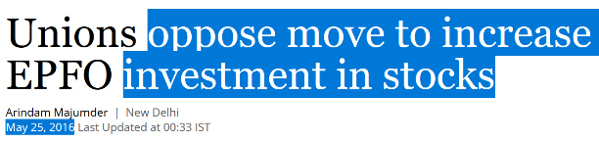
subscribers -> EPF -> where is the money invested?
Invest?
Min.
Max
Equity
5%
15%
C-Bonds
35%
45%
G-Sec
45%
50%
Labour union don’t like it..
NPA, corporate governance.
Survey: infra, high projects
Financial repression

Slide 7
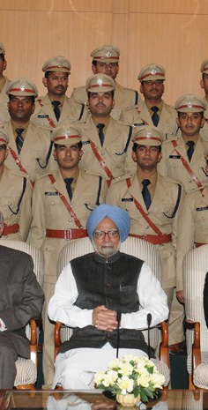
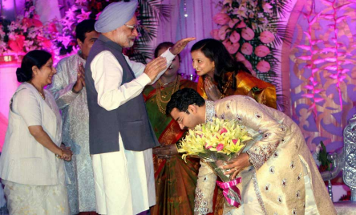
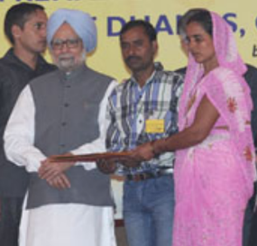
2003: New pension scheme (NPS)
Salary-> NPS Fund manager [SBI, HDFC]
Asset-E : Equities
Asset-C: Corp.Bond
Asset-G: only G-sec.
Central Government recruits 1/1/04
Return is based on “RISK”
You’ve to decide “basket”
Government doesn’t contribute**
“2009”: open for citizens, “Voluntary”
=“National” Pension System
2010: Swavlamban-
NPS-Lite: unorganized co-contributory if not covered elsewhere
EPFO: Majdoor (UAN) | Maalik (LIN)
NPS- PRAN: Permanent Retirement Account Number
Notes:
** except some selected posts.
Armed force
Swavalamban (NPS-lite)
Person from unorganized sector [i.e. not covered in any existing SS scheme, not Government employee]
He has to pay min.1k premium
Government to pay 1k /pa x 5 years
Co-contribution scheme. [Stopped from 2016-17]
Exit @50 age / 20 years [whichever late]
Min. pension 1k/pm.
Budget 2015: Atal Pension [@60 years], old swav. Converted unless they opt-out.

Slide 8
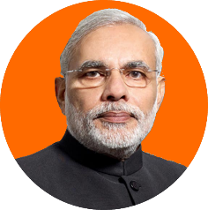
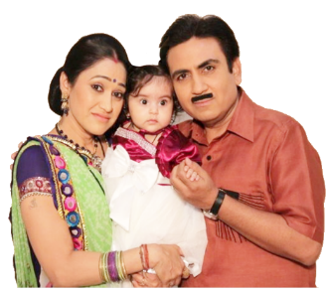



Dept of Financial Services: Atal Pension Yojana (APY), 2015
Apply:
18-40 (1 day less)
Swavlamban
auto-migrated.
Co-contribution?
Max 1k, for 5 years,
if joined by 2016,
Provided not covered in existing scheme like EPFO, plantation, J&K..and not IT payer.
Both husband- wife die, then nominee gets premium
Monthly auto debit
Rs. 42-210 till 60 age
If Jetha die before 60 age..she Gets premium OR if she continues to pay..she gets pension
@60 age, 1k-5k monthly pension.
G-Sec
NRI not eligible, 1 person 1 saving account only.
Notes:
Budget 2015 announced
Eligibility: 18 to 40 years
Unorganized workers to get pension after 60 years age.
Can’t exit before 60 age
Pension of Rs.1k, 2k, 3k, 4k and 5k per month, depending on contribution by the client.
PFRDA to implement, money auto debited from your bank account
Previous Swavlamban scheme had similar feature- Government to co-contribute in unorganized sector worker's NPS account.
Now all those Swavlamban accounts to be migrated to Atal Pension Yojana, unless the client wants to opt out. Then he'll continue in NPS.

Slide 9
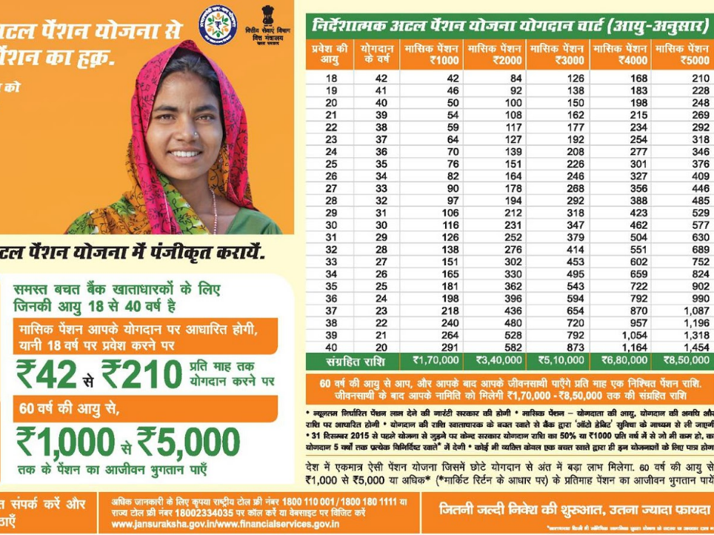

Slide 10
UPSC Prelims CSAT-2016
51. Regarding ‘Atal Pension Yojana’:
It is a minimum guaranteed pension scheme mainly targeted at unorganized sector workers.
Only one member of a family can join the scheme. <WRONG>
Same amount of pension is guaranteed for the spouse for life after subscriber's death. <right>
Select the correct answer using the code given below.
(a) 1 only (b) 2 and 3 only
(c) 1 and 3 only (d) 1, 2 and 3

Slide 11
EPFO vs NPS?
$ Deposited
$ Interest Earned
$ Redeem @Maturity
EPF/PPF has “Exempt-Exempt-Exempt”
NPS have this “Exempt-Exempt-Taxable”. (EET)
Hence difficult to get more subscribers.
Besides, atal pension is for poor..who mostly don’t come in IT bracket!
Budget 2017: upto 25% withdrawal then no tax…WEF 2018
Notes:
At present, IT act Sec 80C now allows tax reliefs for upto Rs.1.50 lakh invested in PPF, NPS, Insurance etc. Rajanbhai says this limit should be increased further. In recent years, National savings rate reduced from >35% to ~30% of GDP. IF tax relief increased, juntaa will save more money and through financial intermediaries it can become credit/capital for faster growth of Indian economy.

Slide 12
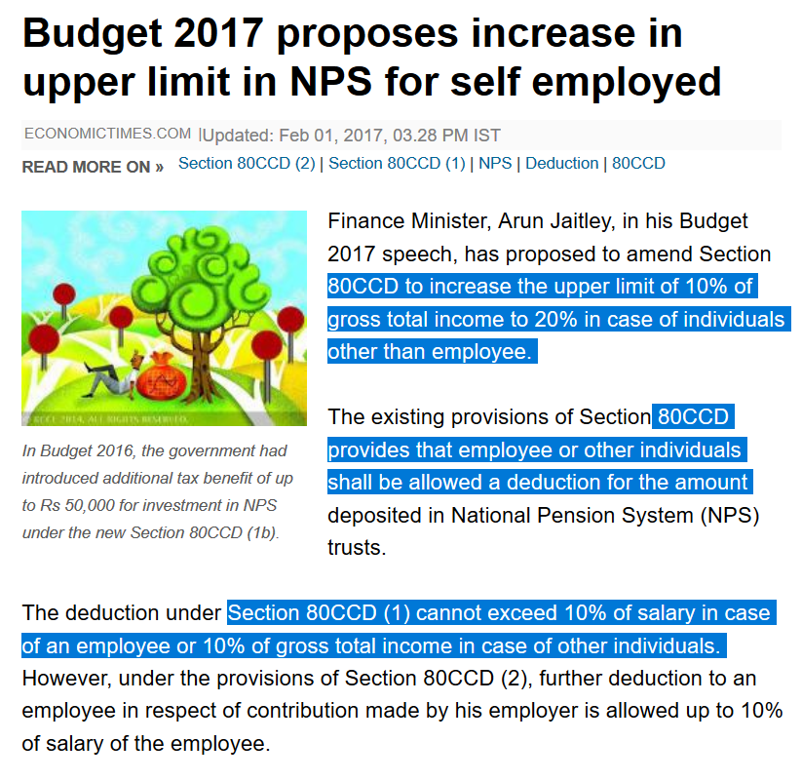
Self employed: 20% deduction in income tax
UPSC doesn’t ask such “Chartered Account” questions.
Don’t waste time.
Notes:
to provide parity between an individual who is an employee and an individual who is self-employed, it is proposed to provide that the self-employed individual shall be eligible for deduction upto twenty per cent of his gross total income in respect of contribution made to National Pension System Trust.

Slide 13
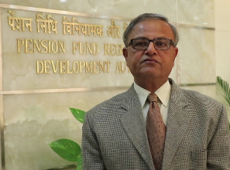
GSM2: Write structure and function of PFRDA
IRDA Chief: TS Vijayan (LIC career officer)
SBI Chief: Arundhati Bhattacharya (SBI PO)
RBI Gov M.Narsimhan (RBI Career officer)
Moral: if can’t become IAS= end of life.
2003: executive order
2013: Pension Fund Regulatory & Development Authority Act
2014: operational
Pension FDI = insurance FDI (49%)
Chairman
3 Fulltime
(3 as per act?)
2 Part time as per site
5 yr / 62 age
5 yr / 65 age
Hemant G Contractor
SBI PO’1974
Total 6, re-appointment yes.
Post retirement 2 years cool-off before joining any pension co.

Slide 14
Functions
PFRDA
Implement National pension system (NPS), select its fund-managers.
Regulate all public and private pension funds except EPFO, J&K, Seaman, Coal miners, Assam tea plantations
Protect Clients, Pensioners
Liquidity, auditing, investment.
Powers of civil court
Documentation, fin awareness

Slide 15
Investment norms on Pension Fund (dept fin services)
Investment | Min | Max
G-sec | 45% | 50%
Debt instruments | 35% | 45%
Short term Debt |  | 5%
Equities | 5% | 15%
Real estate investment trusts (ReITs) |  | 5%
RBI, SEBI, IRDA also setup regulations. So finmin setup a Committee 2016, Oct to consolidate the regulation of pension sector.

Slide 16
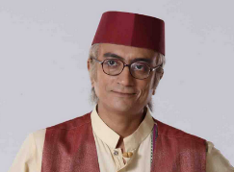
Varishtha Pension Bima Yojana (VPBY)
Department Fin services
2003 | 55 age
9% annual interest in LIC investment. If less return, Government subsidy to LIC.
Post demonetization: PM Modi announced a guaranteed interest of 8 per cent for 10 years. [or take as ‘pension’ on 1, 3, 6, 12 monthly basis.]
VPBY-2017: subscribe in one year.

Slide 17
Social security
Pension
BUT what if you want it free?
EPF
NPS
Atal (NPS-Lite)
Insurance
ESIC
Varistha Pension Bima (LIC)
National social assistance program
You’ve to contribute money

Slide 18
Rural Ministry: National Social Assistance Programme(NSoAP) for BPL [1995]
Components
Old age pension @60
Widow pension 40-59
Union
Rs.200-500*
Rs.200
State
May give extra..
Samajwadi Pension
Vay-Vandna Yojana: (200+200=400)
Rs.200/>
Guj Niradhar Vidhva Sahay Yojna [Total 750+ minor kids allowance]
Disability pension: 18-59
Guj: Sant Surdas Scheme
Same as widow
Death of bread winner 10k
National Family Benefit INSURANCE
Guj: Sankat Mochan (Total 20k)
Annapurna (2001)
If senior citizen uncovered.. 10kg grain / pm free.
??
Among the 6 “Core of the core” CSS
Notes:
Depending on age.

Slide 19
Financial inclusion | वित्तीय समोवेशन: 4 Pillars
Banking
Credit
Insurance
Investment
Small Savings,
PM SB, JJ
Pension
“Social Security”
Notes:
Credit
Loan @affordable rates
Savings
Banking
Small Savings
Investment
Long term Lifecycle needs
PENSION, Higher Education
Insurance
Life and Non-Life (General)

Slide 20
Insurance as a “sector” already covered.
Insurance Nationalization
Insurance Ombudsman
Rural and Social obligations
Insurance Amendment 2015
Agent, mis-selling..
FDI approval
Here we’ll learn Insurance “schemes” for financial inclusion
Life
rPLI
PM-SB
Health
Rashtriya [BPL]
JJ
Accident cum death
Aam Admi Bima
Crop
General
Fasal Bima
ESIC

Slide 21

1884: Postal life insurance for employees -> rural PLI for all
PLI 6 plans
whole life assurance (Grama Suraksha); convertible whole life assurance (Grama Suvidha); endowment assurance (Grama Santosh); anticipated endowment assurance (Grama Sumangal); 10 years RPLI (Grama Priya); and children policy (Bal Jiwan Bima)
RPLI 6 plans
Whole life assurance (Suraksha); convertible whole life assurance (Suvidha); endowment assurance (Santosh); anticipated endowment assurance (Sumangal); joint life assurance (Yugal Suraksha); and children policy (Bal Jiwan Bima)
+ UTI MF, Money transfer, post office savings bank, post office small savings schemes, Payment bank in 2017 <LINK>

Slide 22


2015: Dept of Financial Services
Apply: 18-50 age
1 year “term life” insurance
Term insurance= no death, no money
Premium: Annual Rs.330/- per person. bank autodebit.
+ 11 bank’s charge
+ 20 to BCA/Agent
+ 289 to life insurance company
=330
LIC & even pvt Life insurance cos also.
Any type of death within year= 2 lakh.
NRI eligible but payment in rupee currency only
Notes:
Budget 2015 announced
Eligibility: 18 to 40 years
Unorganized workers to get pension after 60 years age.
Can’t exit before 60 age
Pension of Rs.1k, 2k, 3k, 4k and 5k per month, depending on contribution by the client.
PFRDA to implement, money auto debited from your bank account
Previous Swavlamban scheme had similar feature- Government to co-contribute in unorganized sector worker's NPS account.
Now all those Swavlamban accounts to be migrated to Atal Pension Yojana, unless the client wants to opt out. Then he'll continue in NPS.

Slide 23



2015: Dept of Financial Services
Apply: 18-70 age
Health Certi not req.
1 year term accident cum death cover
Annual Rs.12/- per person. bank autodebit.
+ 1 bank’s charge
+ 1 to BCA/Agent
+ 10 to GENERAL company
=12
4 pub & even pvt Gen. insurance cos also.
NRI eligible but payment in rupee currency only
Notes:
Budget 2015 announced
Eligibility: 18 to 40 years
Unorganized workers to get pension after 60 years age.
Can’t exit before 60 age
Pension of Rs.1k, 2k, 3k, 4k and 5k per month, depending on contribution by the client.
PFRDA to implement, money auto debited from your bank account
Previous Swavlamban scheme had similar feature- Government to co-contribute in unorganized sector worker's NPS account.
Now all those Swavlamban accounts to be migrated to Atal Pension Yojana, unless the client wants to opt out. Then he'll continue in NPS.

Slide 24
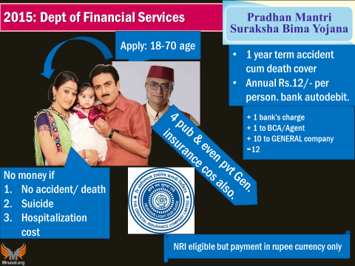
“SU” = Suicide
JJ: in any case if “Jeevan” Jyoti gone, then $$
money
“Accidental Death”: murder, natural disaster etc. Rs. 2 lakh
2 organs/>: max.2 lakh
No money
No death, no accident.
Hospitalization cost <buy health insurance>
1 eye/hand/leg: 1 lakh
Natural death <buy JJ>
Suicide <buy JJ>

Slide 25
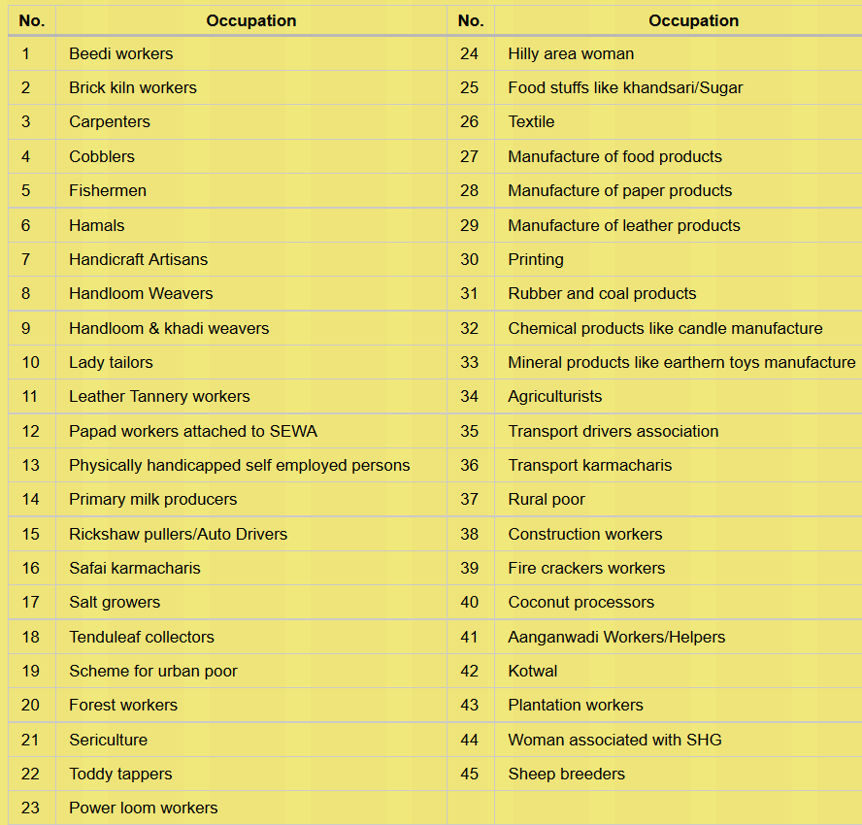
Unorganized workers “group insurance”: Janshree Bima Yojana (2000) 30k to 75k on death / disability
18-59 age group
BPL
Marginally APL
Shiksha Sahayog Yojana (SSY) scholarship addon Rs. 100 monthly
But all this merged into Aam Admi Bima Yojana (LIC) from 2015. “FREE”

Slide 26
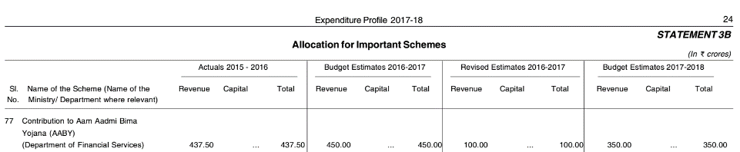
will “aam Aadmi” be removed / merged with SB someday?
insurance
Life
rPLI
PM-SB
Health
Rashtryia [BPL]
JJ
Accident cum death
Aam Admi Bima
Crop
General
Fasal Bima
ESIC<self-study>
Jan Suraksha Yojana
Free for BPL

Slide 27
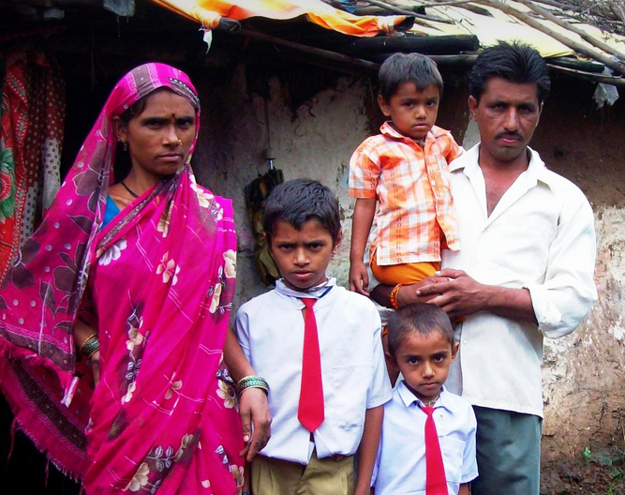
Rashtriya Swasthya Bima Yojana -Universal health insurance scheme
Only BPL [upto 5 people in a family, NO AGE LIMIT]
Only 1 time Registration Rs.30
No premium. Govt bears it.
30k for medical treatment [smartcard, cashless].
even existing ailment, even private hospital.
25k for accidental death
Breadwinner dies: Rs.50 x 15 days
2008
Labour Min
2014
Health ministry [admin]

Slide 28

Niramya Health insurance for PwD
Premium
BPL: 250
Minor without parents: free
Treatment
Upto Rs. 1 lakh
APL: 500

Slide 29

PM Fasal Bima Yojana 2016, Jan
Scheme
Gone National Agricultural Insurance Scheme and Modified NAIS
Against natural calamities before, during and after harvest.
Remote sensing, smart phone, DBT for payment; Gujarat: only e-portal
Kharif
2%
Rabi
1.5%
Horticulture/Commercial
5%
Of the Total insurance premium

Slide 30

PMFBY ► Agri Min ► where does the premium go?
1
Sarkaari Agriculture Insurance Company of India Limited (AIC)
4
Sarkari General Insurance cos.
11
Private insurance cos.

Slide 31
UPSC prelim CSAT 2016
96. With reference to ‘Pradhan Mantri Fasal Bima Yojana', consider the following statements:
Under this scheme, farmers will have to pay a uniform premium of 2% for any crop they cultivate in any season of the year. <WRONG>
This scheme covers post-harvest losses arising out of cyclones and unseasonal rains. <right>
Which of the statements given above is/are correct?
(a) 1 only (b) 2 only
(c) Both 1 and 2 (d) Neither 1 nor 2

Slide 32
Financial inclusion | वित्तीय समोवेशन: 4 Pillars
Banking
Credit
Insurance
Investment
Small Savings,
PM SB, JJ
Pension
“Social Security”
Notes:
Credit
Loan @affordable rates
Savings
Banking
Small Savings
Investment
Long term Lifecycle needs
PENSION, Higher Education
Insurance
Life and Non-Life (General)

Slide 33

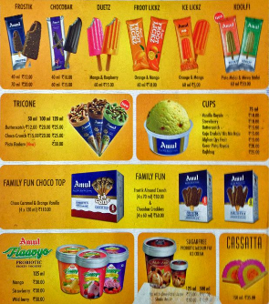





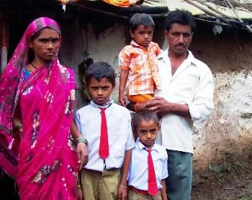
exclusive Tax benefit?. No
Max? 5k pension
Max? 2L insurance
42/-
pm
Rs. 100
12/-
pa
330/-
pa
not meant for income tax payers [PPF, NPS, LIC/MF plan]
Bringing them into the “NET”. With own money=> More keen to seek “Claim”.
2nd generation growth.
Notes:
Cover / Pension insufficient in this age of inflation
No tax benefits on Atal pension.
Counter: middle class can opt for higher products
These 3 only for bottom strata of the society.
If junta’s insurance/pension habit cultivated => Fiscal deficit ▼

Slide 34

If we do Financial inclusion of all Indians then….
Life “S-E-T” ho jaaye
Economic Security
Social security
Pension
Loan
Subsidies
Salary (MNREGA)
Insurance
Transaction security
Remittance
Bank money, digital payment
Ponzi schemes, MLM, Money lenders debt-trap: suicide
Savings into investment, gold-real estate charm ▼[black money]
Child labour, human trafficking, prostitution.. ▼
Japan, S.Korea, USA: Social harmony, women Empowerment
+ <insert> advantages of cashless economy lecture LINK

Slide 35
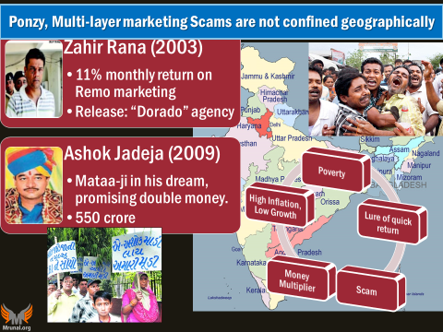

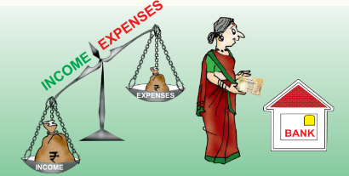

Financial Literacy
Financial Inclusion
Human Development
Financial Stability
Notes:
Role of Financial inclusion in human development ?

Slide 36
Mock Question for Mains / Essay
Examine the significance of financial inclusion as a "means" to improve Human Development in India. 200 words.
Ans.
Define: covering all in the four nets.
Body#1: How it helps.
Body#2: why alone not sufficient.
Conclusion: findings <Financial inclusion combined with financial literacy.>

Slide 37
Don’t confuse words “Social security” vs “social justice”
10% of PSL to weaker section
Stand up India for SC/ST,
Padho Pardesh for minorities…
Banking
Credit
Insurance
Investment
Small Savings,
PM SB, JJ
Pension
Pension and Insurance is Social Security
Notes:
Credit
Loan @affordable rates
Savings
Banking
Small Savings
Investment
Long term Lifecycle needs
PENSION, Higher Education
Insurance
Life and Non-Life (General)

Slide 38
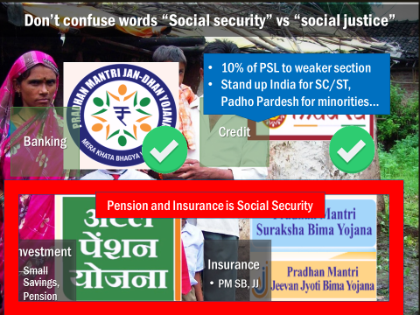
Don’t confuse words: Social Security vs Social Justice
Reservation in Government jobs, admission and election
civil rights, atrocity prevention, personnel laws…
Social Justice | Gender Justice …..all are means / tools for…
End targets: Human Development, SDG, inclusive growth….
Students say "my essay, mains, interview went fine!" but still no selection, because they answer in a wrong direction.

Slide 39

Economy: 6 pillars + theory + current + BES17
1.Banking, Fin, Insur.
6.HRD
2.Budget
3.BoP
4.Sectors
5.Infra
V1:c3,4
V1:c2,3, 6,9,11(GST),13
V1c:5
V1c:7(Textile),11(trade)
V1c:10
v1c:12, 14; Budget^Rail

